Slide 1
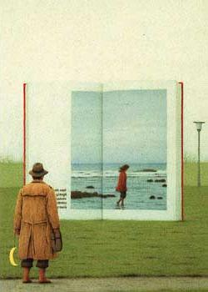
CS 180/280A: Intro to Computer Vision and Computational Photography
Instructor: Alexei Efros
GSIs: Hang Gao
Vongani Maluleke
Tutors: Daniel George
Ryan Tabrizi
Max Vogel
Bill Zheng
UC Berkeley, Fall 2024
© Quint Buchholz

Slide 2
Today
Introductions
Why this Course?
Administrative stuff
Project #1 out!
Brief History of Visual Data

Slide 3


Teaching team: Instructor
Social warning –
I don’t see well
Alexei Efros
Professor in BAIR, focus on Computer Vision and Machine Learning

Slide 4
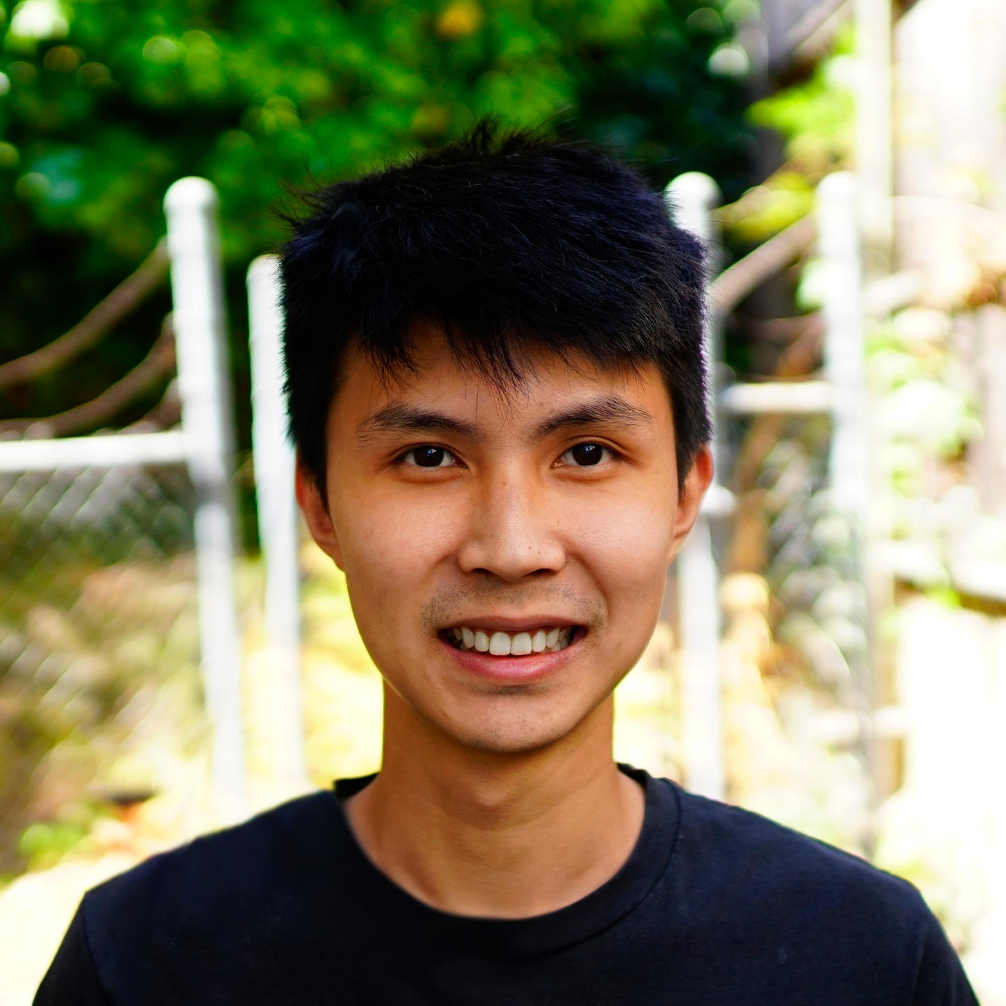
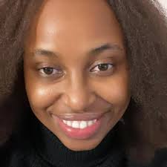
Teaching Team: GSIs
Hang Gao
Vongani Maluleke
PhD students in BAIR, expertise in Computer Vision

Slide 5

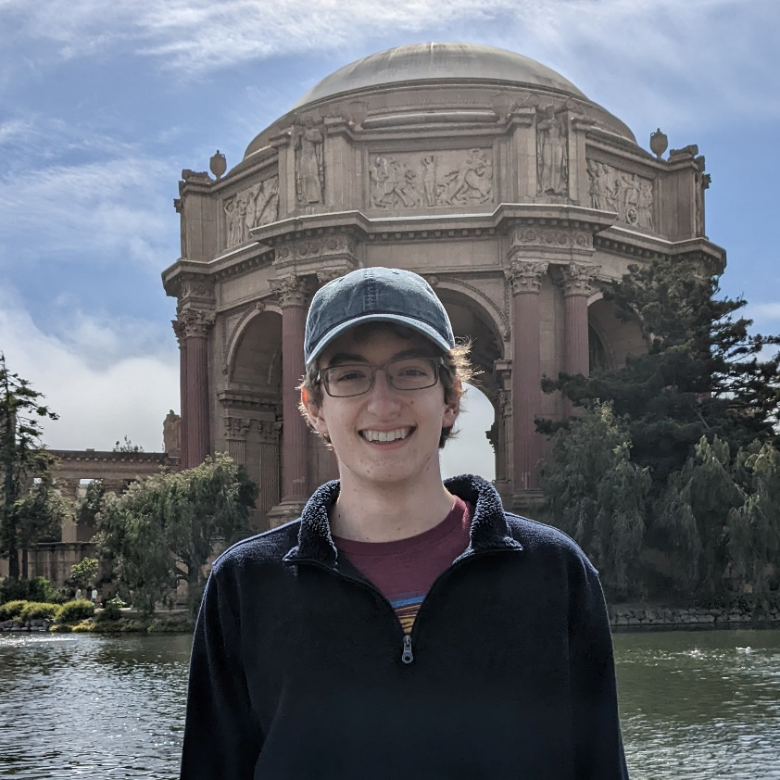
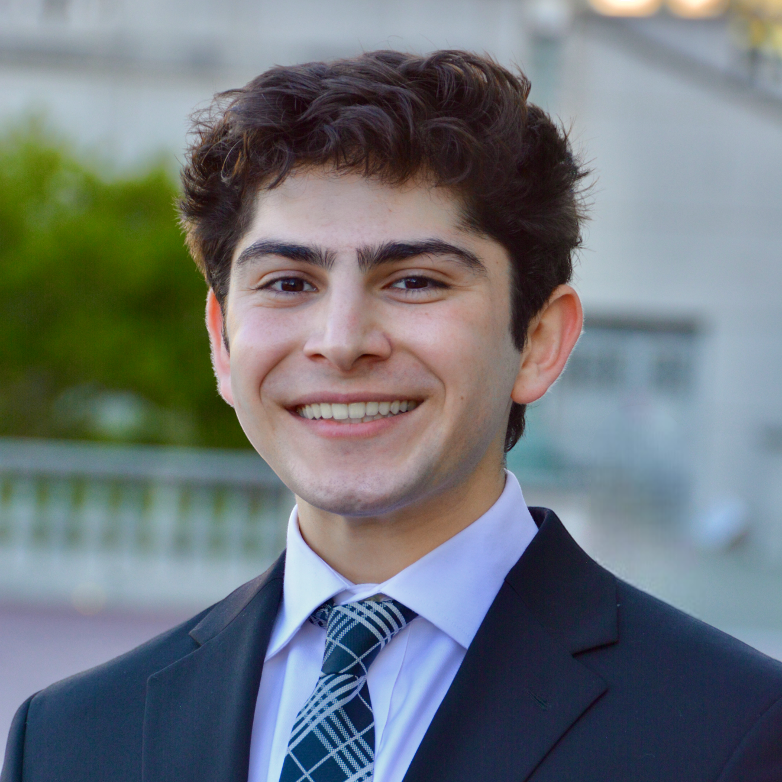
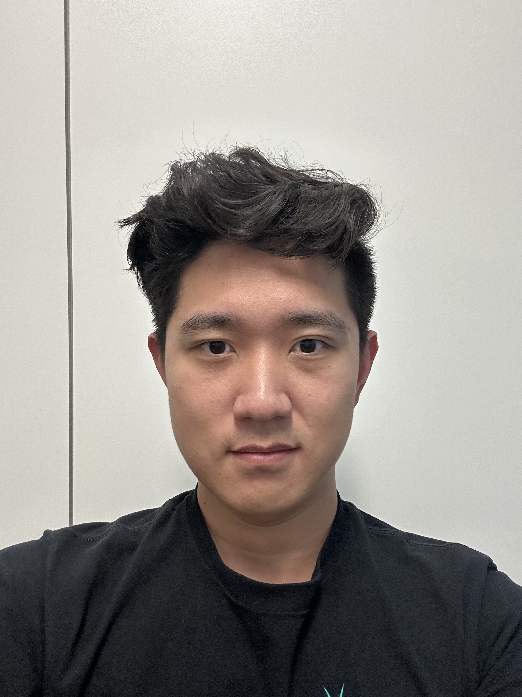
Teaching Team: Tutors
Daniel
George
Max
Vogel
Ryan
Tabrizi
Bill
Zheng

Slide 6
Why This Course?

Slide 7
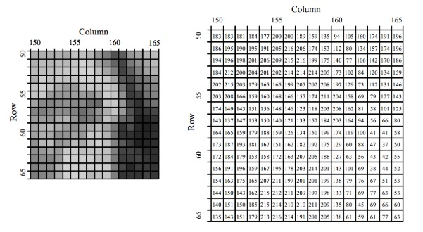
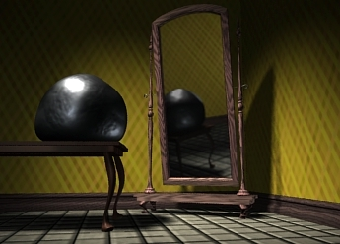
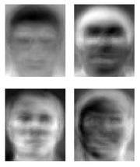
Visual Computing in the old days…
Image Processing
EECS 225B
Computer Graphics
CS 184
Computer Vision CS 280

Slide 8
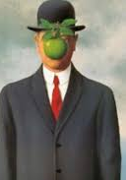

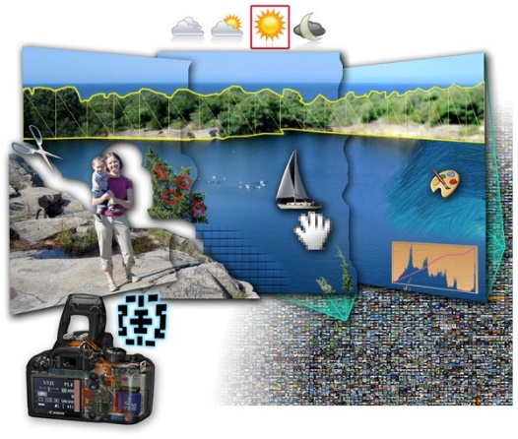

Visual Computing gets interconnected
Image Processing
EECS 225B
Art History
ART 10
Computer Graphics
CS 184
Computational
Photography
Visual Perception
PSYCH
Machine
Learning
Computer Vision CS 280

Slide 9
Visual Computing gets interconnected
CS180
Image Processing
EECS 225B
Art History
ART 10
Computer Graphics
CS 184
Computational
Photography
Visual Perception
PSYCH
Machine
Learning
Computer Vision CS 280

Slide 10
CS180: Focus on Visual Data
The key objective of this class is to become friends with every pixel!

Slide 11
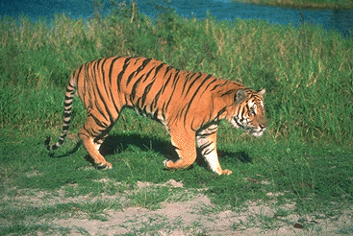

Course objectives
You will appreciate the fundamental difficulty of understanding and computing with visual data
Notes:
Foundation for computer vision. We want machines to watch for us, do our work, and make us live longer, more healthy, and more entertaining lives. This course will give you a good hands-on background for learning more or developing new computer vision applications.

Slide 12
Course objectives
2. You will get a foundation in image processing and computer vision, from the ground up:
Camera basics, image formation
Convolutions, filtering
Image and Video Processing (filtering, anti-aliasing, pyramids)
Image Manipulation (warping, morphing, mosaicing, matting, compositing)
Projection, 3D, stereo
Data-driven methods
Generative Models
…
Notes:
Foundation for computer vision. We want machines to watch for us, do our work, and make us live longer, more healthy, and more entertaining lives. This course will give you a good hands-on background for learning more or developing new computer vision applications.

Slide 13
Course objectives
3. You will get a more intuitive understanding of important mathematical and computational concepts
Gradients
Change of basis
interpolation, extrapolation
Furrier Transforms
PCA
Deep Learning
Auto-regressive Models
Diffusion Models
…

Slide 14
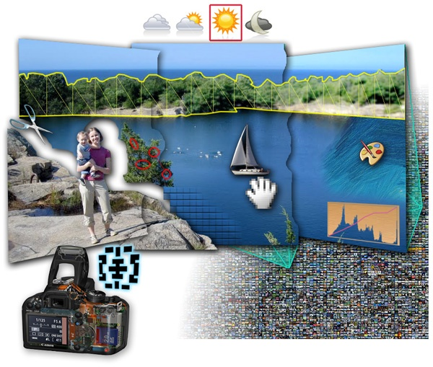

Course objectives
4. You will learn approaches for visual synthesis
Graphic by James Hays
DALL-E + Danielle Baskin
Notes:
Visual creation is no longer just pure graphics or pure photography. There is a growing need to blend the two. We want to edit photos, work with photo collections, create cool special effects, etc. After this course, you should have the background and experience that you need to do these things.

Slide 15
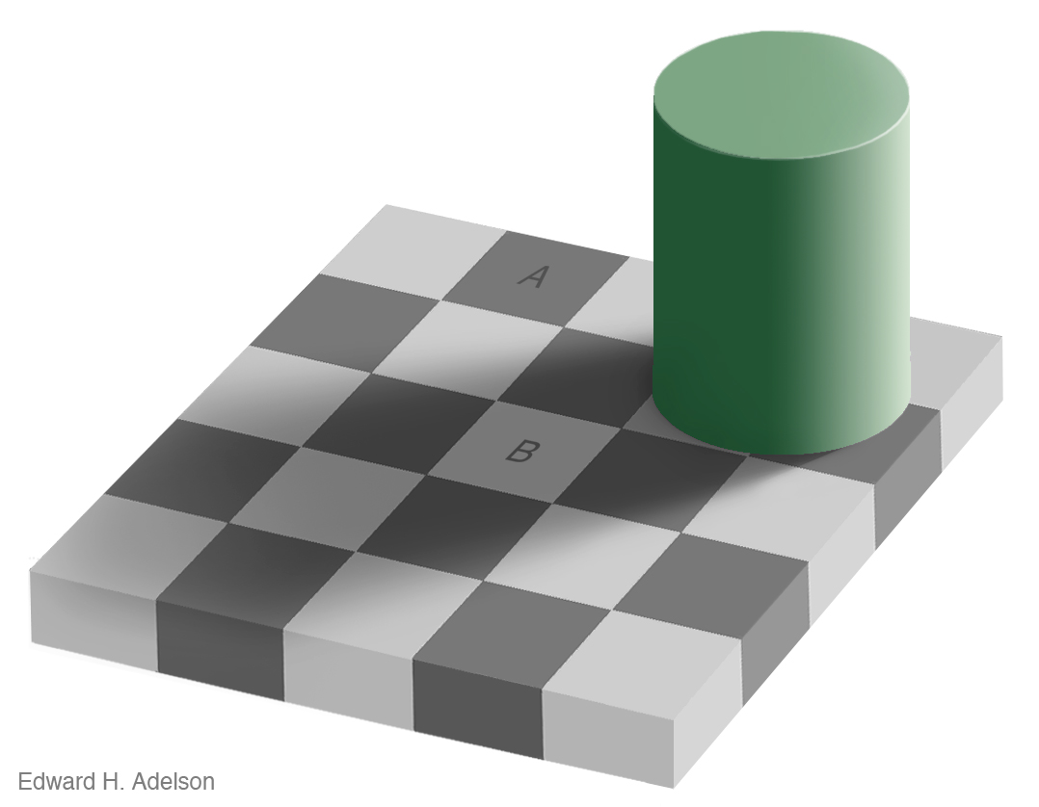
Course objectives
4. You’ll better appreciate human visual perception
Notes:
You'll gain an appreciation for your own visual ability. We tend to take it for granted, but half of our brain is cranking away on the vision problem. Interestingly, we are usually aware only of the interpretation, not what we actually see. By working with pixels, you'll see how messy images actually are and how incredible it is that we can interpret anything from them.

Slide 16
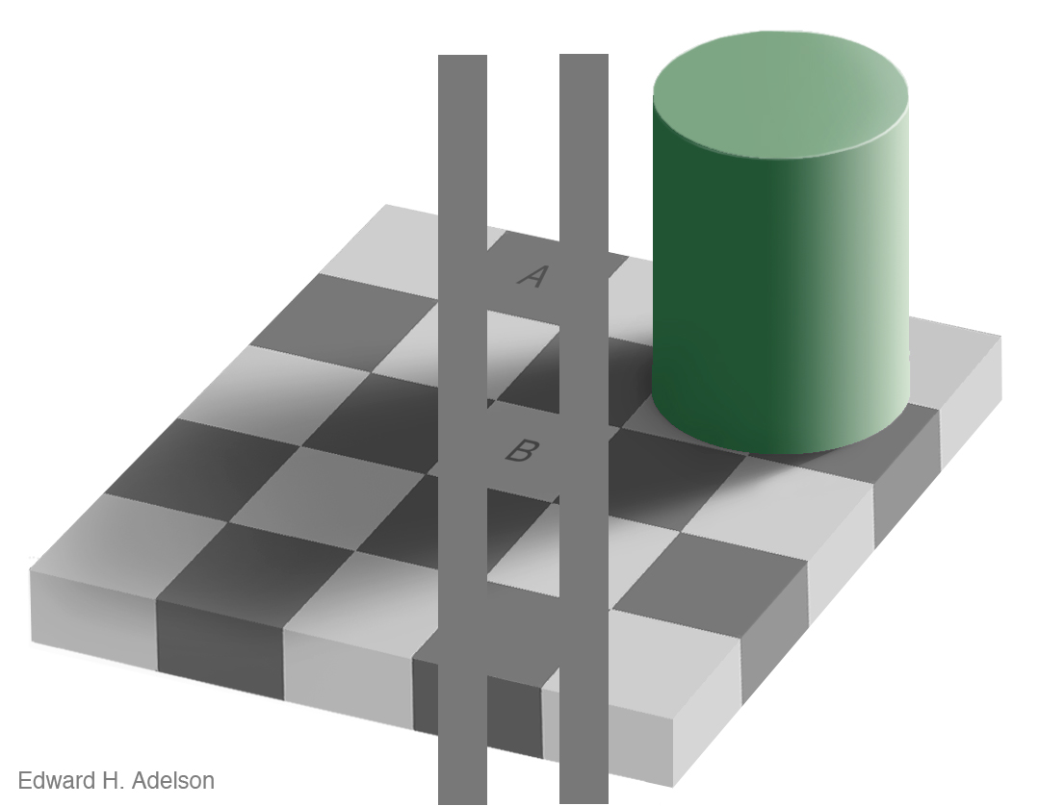
Course objectives
4. You’ll better appreciate human visual perception
Notes:
You'll gain an appreciation for your own visual ability. We tend to take it for granted, but half of our brain is cranking away on the vision problem. Interestingly, we are usually aware only of the interpretation, not what we actually see. By working with pixels, you'll see how messy images actually are and how incredible it is that we can interpret anything from them.

Slide 17
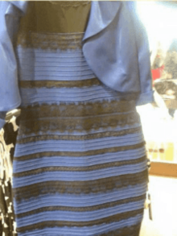
Different people see different things
https://en.wikipedia.org/wiki/The_dress

Slide 18
Course objectives
5. You will learn about the history of ideas in visual computing
Did you know Large Generative Models go back to 1940s?
Or that Deep Learning started with a Nobel Prize on Neuroscience of the Visual Cortex in the 1960s?
…

Slide 19
Course objectives
6. You’ll have fun doing cool stuff, coding up a storm, largely from scratch
Notes:
Do cool stuff. You'll get the opportunity to implement a variety of fun projects that work with your own photos. You can be creative. You can also go beyond the minimum and do some "bells and whistles" or additional projects that I offer. You'll get to do a final project on whatever you want. You'll also be able to see the work that everyone else does.

Slide 20

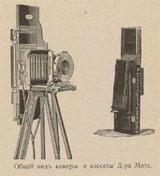
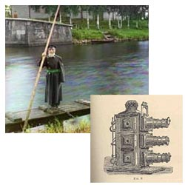
Programming Project #1
Prokudin-Gorskii’s Color Photography (1907)

Slide 21
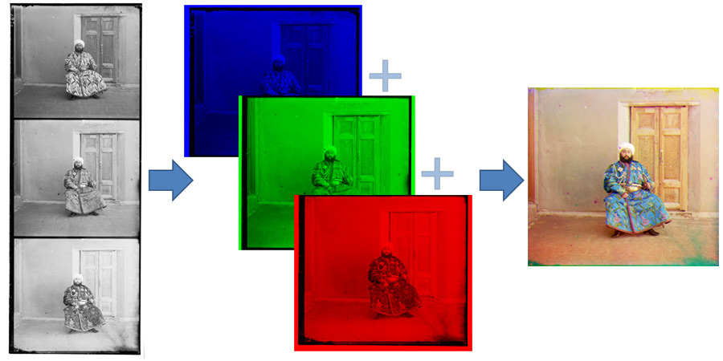
Programming Project #1
Project out TODAY!

Slide 22
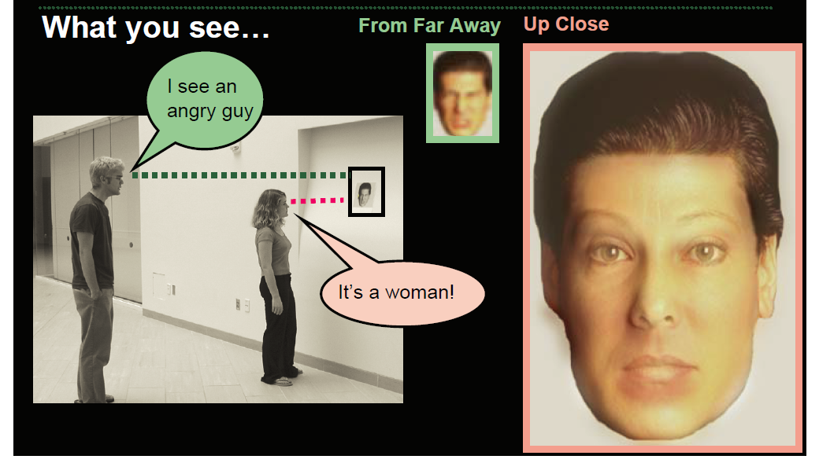
Project 2: Fun with frequencies

Slide 23
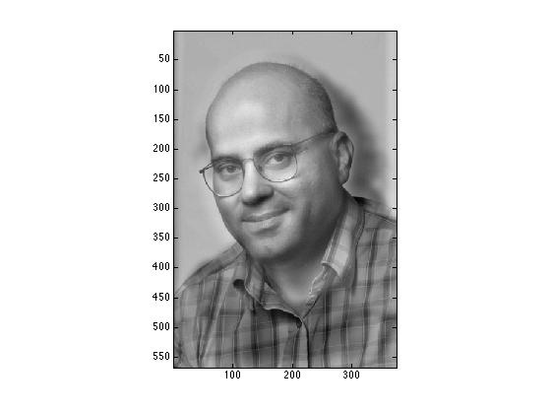
Project 2: Fun with frequencies
Prof. Christos Papadimalik
© Riyaz Faizullabhoy

Slide 24
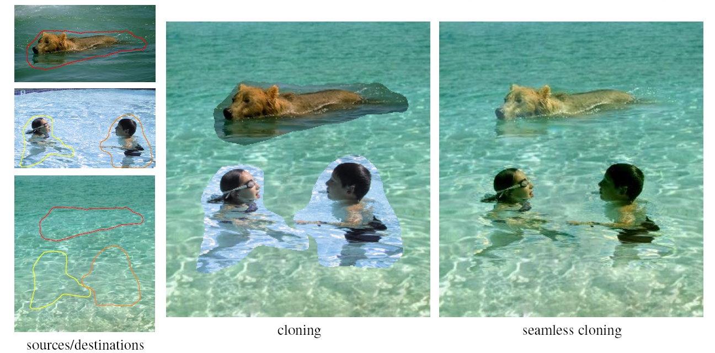
Project 2: Fun with Frequencies

Slide 25
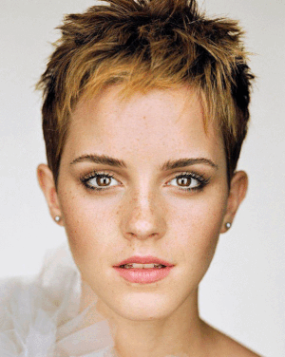
Project 3: Face modeling and morphing

Slide 26
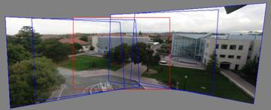
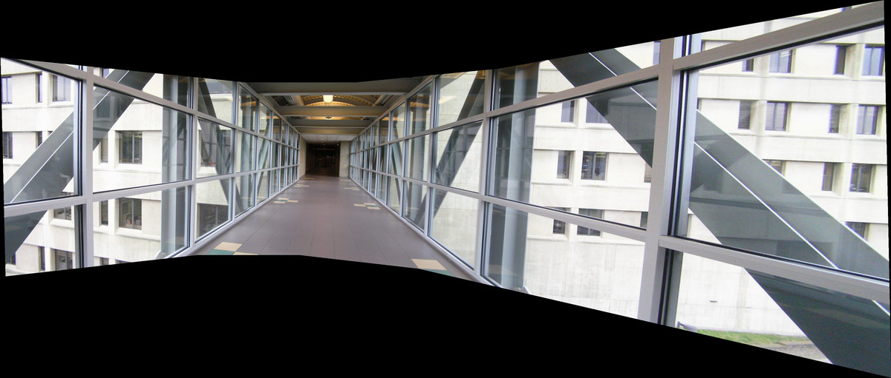
Project 4: Panorama Stitching
Photo Mosaics

Slide 27
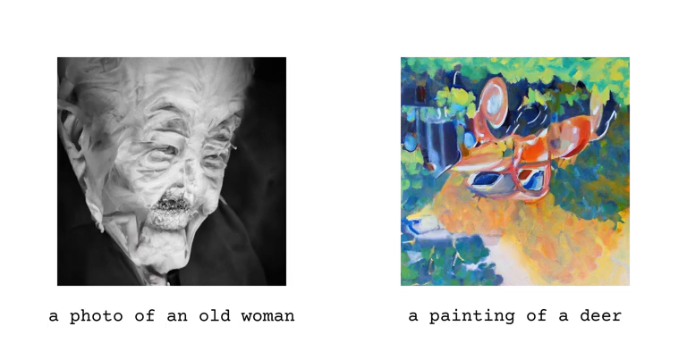
Project 5: Diffusion and Visual Anagrams

Slide 28
Final Project
Something cool!!!
We will have some pre-canned projects
Will also have some suggestions, cool datasets, etc
Or you can do whatever you want!
(can be done in groups of 2 or 3)

Slide 29
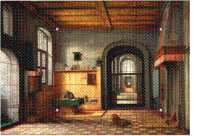
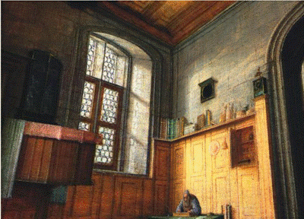
Example Pre-canned Project
Tour Into the Picture

Slide 30
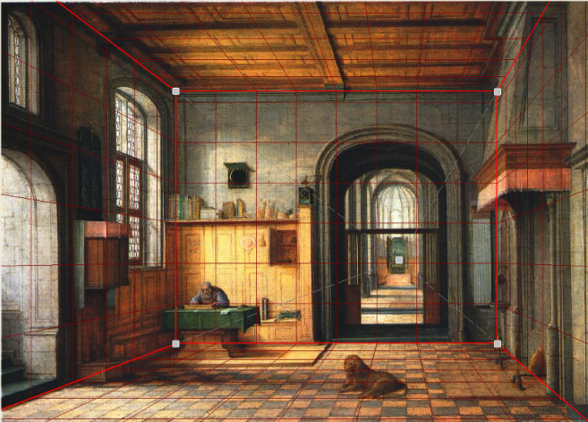
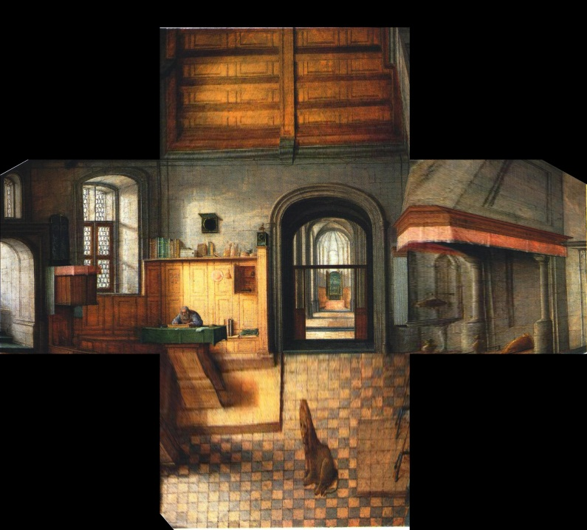
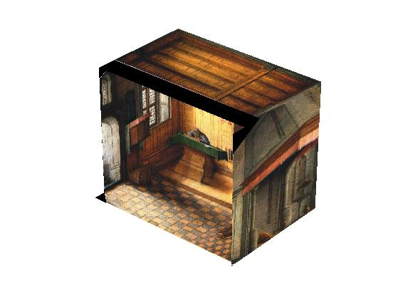
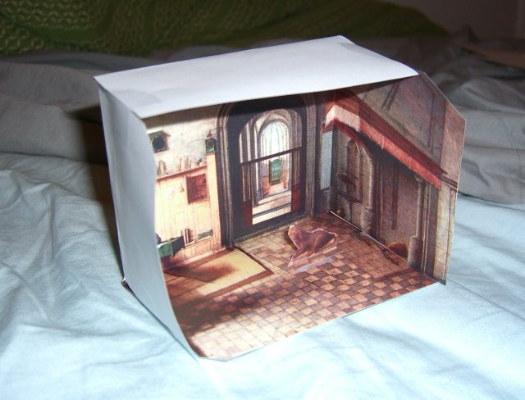
Paper Pop-up
Step 1: define planes
Step 2: rectify each plane
Step 3: compute 3D box coords

Slide 31

Sample final project from previous years

Slide 32
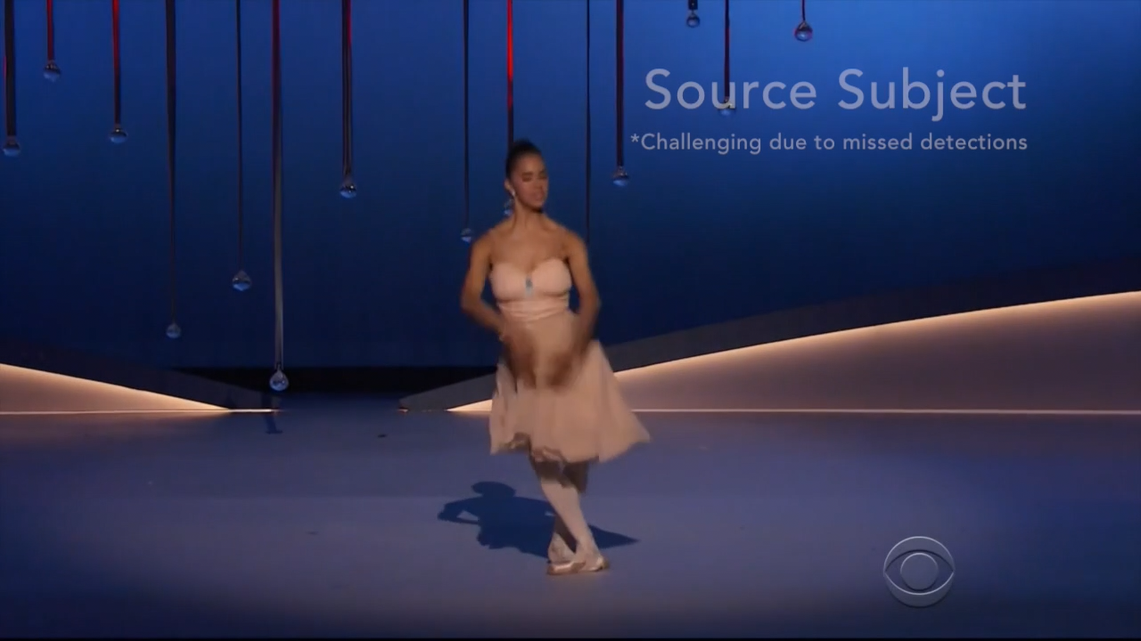
Sample final project from previous years
https://www.youtube.com/watch?v=PCBTZh41Ris&feature=youtu.be

Slide 33
For each project:
Derive the math, implement stuff from scratch, and apply it to your own photos
Every person does their own project (except final projects)
Reporting via web page (plus submit code)

Slide 34
Class Organization / Administrivia

Slide 35
General
Prerequisites
Linear algebra!!! (EE16A, Math 54, Math 56, or Math 110)
Multivariable Calculus (Math 53)
Good programming skills (at least CS61B)
Deep Learning experience (e.g. CS189, CS182, may be concurrent)
Creativity
Emphasis on programming projects!
Building something from scratch
Graduate Version (CS280A):
Final project required (not pre-canned), including conference-style report paper

Slide 36
Administrative Stuff
Grading
60% Programming Projects (5 in total)
20% Final Exam (Last Lecture, Wednesday 12/04/24)
15% Final Project
5% Pop Quizzes
Class Participation: priceless
Late Policy
Five (5) emergency late days for semester. The expectation is you will never use them.
10% each additional day afterwards
Extra Points
Most projects will have optional “bells & whistles”
These extra points could be used to drop one or two quizzes

Slide 37
Rule # 1: No lecture recordings
This is an in-person class. You are to come to the lecture and participate! Attendance is required.
Only available by request for truly exceptional circumstances, e.g. severe illness. See GSIs.

Slide 38
Rule # 2: Deadline is a deadline
In real life there are no extensions
This is a FUN but INTENSE class, projects come one after another
Slip days are for emergencies. If nothing dramatic happened to you during the semester, you should have all your slip days left.
Projects are time consuming. Start early!!!

Slide 39
Rule # 3: TA’s don’t debug code
TA’s don’t debug code for you.
Part of the skill is to learn how to ask questions to debug the issue without presenting the code
Visualize the results and send those to figure out what is wrong
Use the pixels – become friends with visual debugging

Slide 40
Getting help outside of class
Course Web Page
http://inst.eecs.berkeley.edu/~cs180
Online forums:
Ed (add yourself via course webpage)
Gradescope (add yourself via course webpage)
Discussion Sections:
Two each week
see webpage for times
Office hours
For me: after each lecture
For others, see webpage

Slide 41

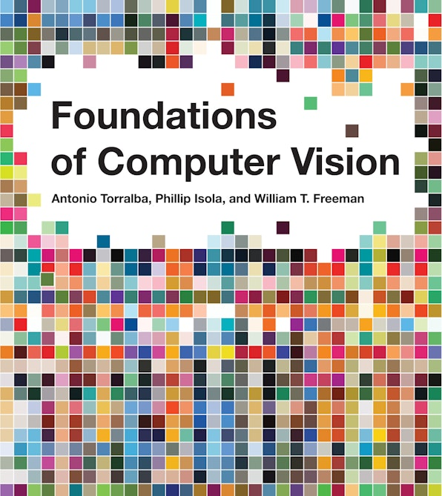
Textbooks
http://szeliski.org/Book/
https://mitpress.mit.edu/9780262048972/foundations-of-computer-vision/

Slide 42
Academic Integrity
Can discuss projects, but never share code
You must type every character yourself
Don’t search for code or copy from a friend
If you’re not sure if it’s allowed, ask
Cite any sources and inspirations

Slide 43
Our GPT policy
GPT is a wonderful tool
And so is calculator, Wolfram Alpha, Wikipedia, Stack Overflow, etc.
but before you use a calculator, it’s important to learn how to do long division by hand.
In this course, we want you to do things from scratch.
So, no Stack Overflow, no searching for code, no fancy libraries, and no GPT
You can use GPT (sparingly) to debug your code, but you must acknowledge and submit transcript of your GPT sessions

Slide 44
Waitlists
We are limited by room size (~300 people)
However, we expect 50-70 people to drop after the first couple of projects ☺
So, chances are good to get in, but you need to start doing projects
For CS280A, everyone is on the waitlist
Fill in this form, if you haven’t already: https://forms.gle/DDBFWN6D1CH5uec58
For Concurrent Enrollment (CE):
Fill in this form, if you haven’t already: https://forms.gle/5cjKzgSoRVjSf9uW8

Slide 45
Warning: historically high GPA of this course
Survivor bias
High class GPA != easy course
This is a FUN but INTENSE class
Many people will drop out, switch to pass/fail.

Slide 46
Why you should NOT take this class
Project-based class
No canned problem sets
No clean rubrics
Open-ended by design
Coding from scratch
Will try to make sure everyone understands the basics super-well, before covering advanced topics
Need time to think, not just hack
Creativity is a class requirement
We already expect you to know Deep Learning!
Lots of work…There are easier classes if
you just need some units
you care more about the grade than about learning stuff
Not worth it if you don’t enjoy it

Slide 47

Now… reasons TO take this class
It’s your reward after 3 grueling years ☺
You get to work with pictures, unleash your creative potential
Interested in grad school? ☺

Slide 48
A Brief History of the Visual Data

Slide 49
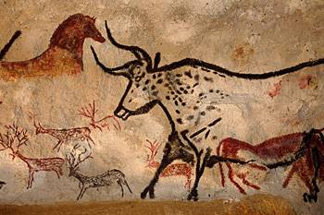
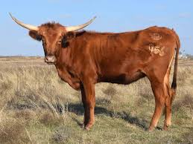
Depicting Our World: The Beginning
Prehistoric Painting, Lascaux Cave, France
~ 13,000 -- 15,000 B.C.

Slide 50
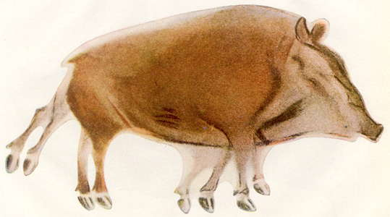
Prehistoric Cave Painting, Altamira
~ 20,000 – 15,000 B.C.

Slide 51
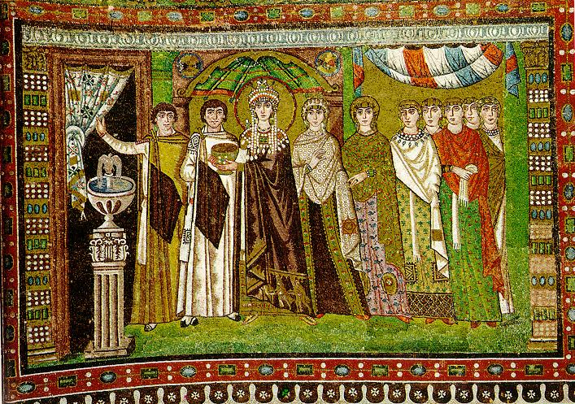
Depicting Our World: Middle Ages
The Empress Theodora with her court.
Ravenna, St. Vitale 6th c.

Slide 52
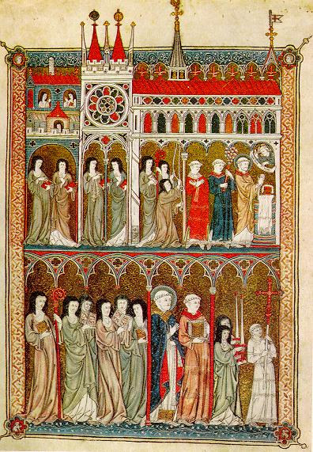
Depicting Our World: Middle Ages
Nuns in Procession. French ms. ca. 1300.

Slide 53
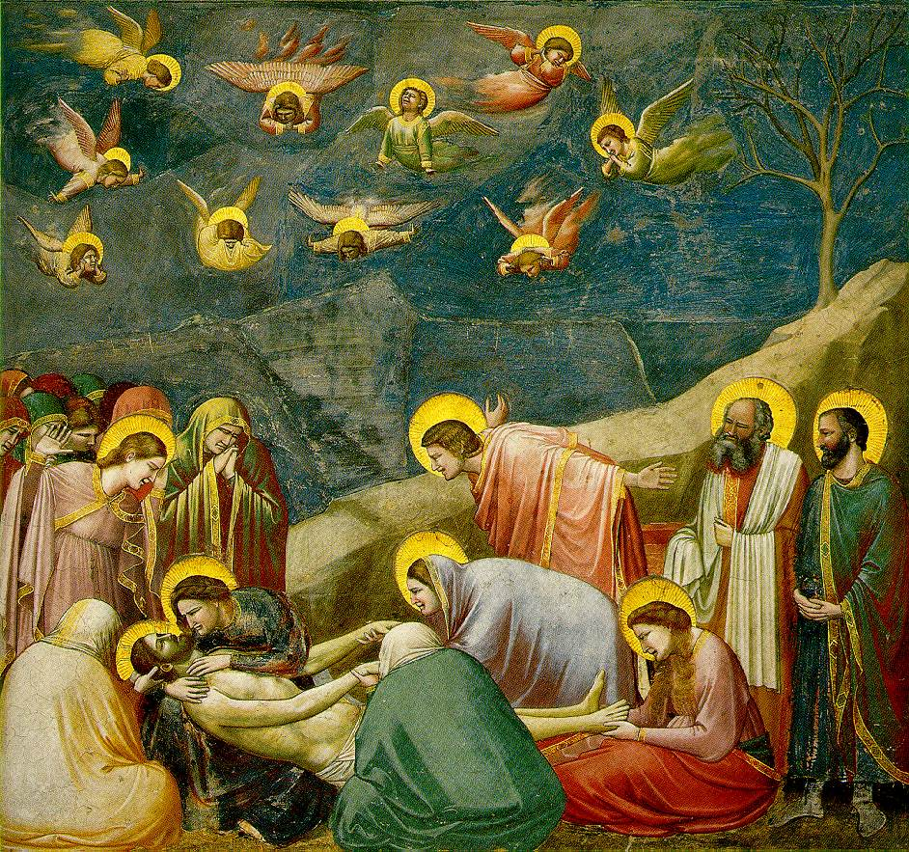
Beginnings of the Renaissance
Giotto, The Mourning of Christ, c.1305

Slide 54
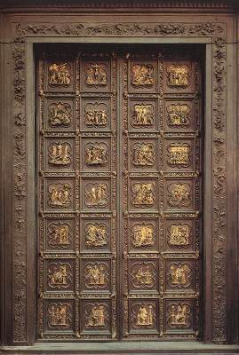
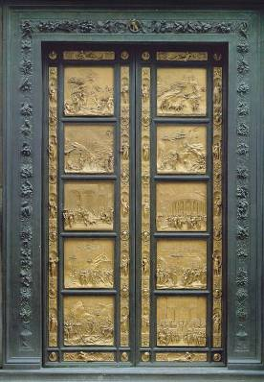
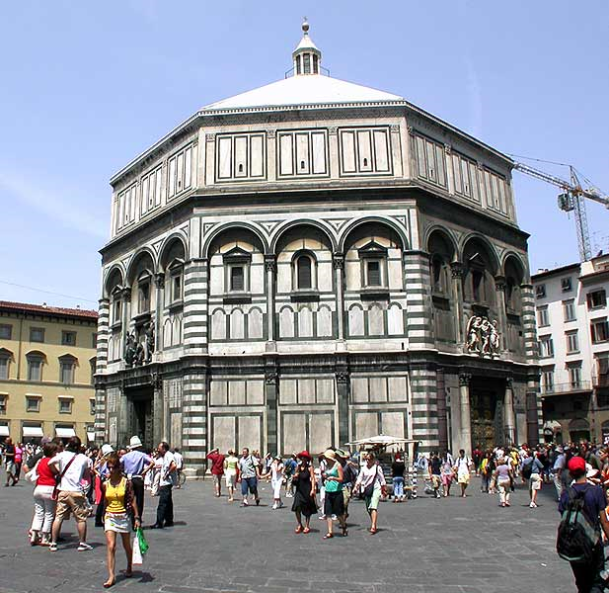
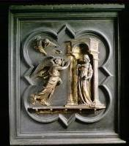
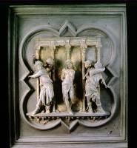
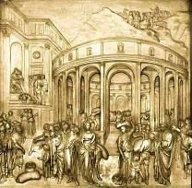
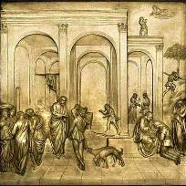
Depicting Our World: Renaissance
North Doors (1424)
Lorenzo
Ghiberti
(1378-1455)
East Doors (1452)

Slide 55
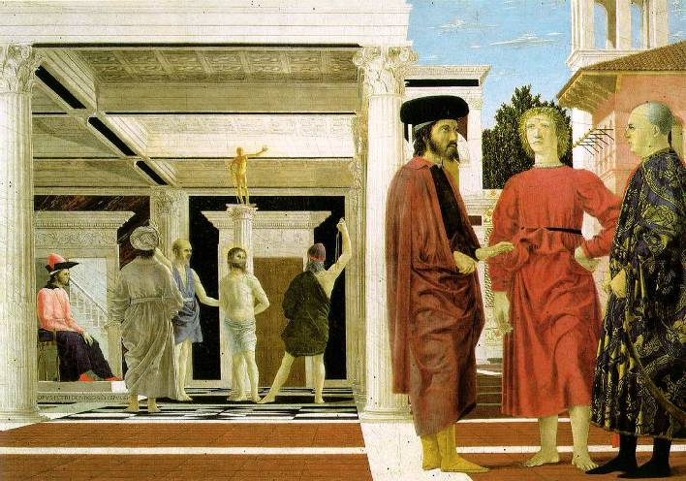
Depicting Our World: Renaissance
Piero della Francesca,
The Flagellation (c.1469)

Slide 56
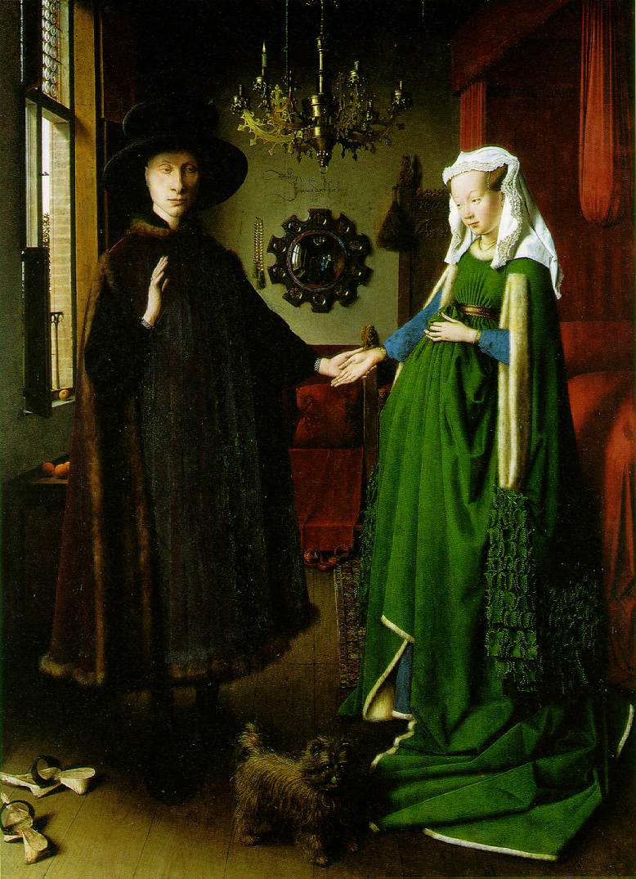
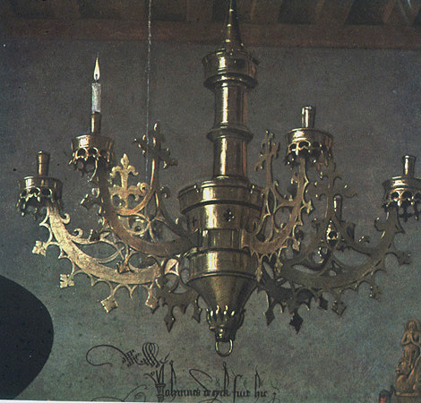

Depicting Our World: Toward Perfection
Jan van Eyck, The Arnolfini Marriage (c.1434)

Slide 57

Depicting Our World: Toward Perfection
Lens Based Camera Obscura, 1568

Slide 58

Depicting Our World: Perfection!
Boulevard du Temple, Louis Daguerre, 1838

Slide 59


Depicting Our World: Realism?

Slide 60







Paris, according to Flickr

Slide 61








Paris, according to Google StreetView
Knopp, Sivic, Pajdla, ECCV 2010

Slide 62












Paris, according to me

Slide 63

After realism…
Monet,
La rue Montorgueil

Slide 64


Depicting Our World: Ongoing Quest
Pablo Picasso
David Hockney

Slide 65

Better than realism?
David Hockney, Place Furstenberg (1985)

Slide 66

Which one is right?
Multiple viewpoints
Single viewpoint
David Hockney,
Place Furstenberg, 1985
Alyosha Efros
Place Furstenberg, 2009

Slide 67

Depicting Our World: Ongoing Quest
Antonio Torralba & Aude Oliva (2002)

Slide 68

Enter Computer Graphics...

Slide 69



Traditional Computer Graphics
3D geometry
projection
Simulation
physics
GRAPHICS

Slide 70

Modern Computer Graphics
Amazingly real
But so sterile, lifeless, futuristic (why?)

Slide 71

The richness of our everyday world
Photo by Svetlana Lazebnik

Slide 72

Beauty in complexity
University Parks, Oxford

Slide 73

Which parts are hard to model?
Photo by Svetlana Lazebnik

Slide 74
Creating Realistic Imagery
Computational
Photography
Computer Graphics
Photography
Realism
Manipulation
Ease of capture
+ great creative possibilities
+ easy to manipulate objects/viewpoint
Tremendous expertise and effort to obtain realism
+ instantly realistic
+ easy to aquire
- very hard to manipulate objects/viewpoint

Slide 75

Pop Quiz!
Don’t worry, this time, we grade only on participation
Quiz designed to diagnose your level of preparation for CS180
Should take about 10-15 minutes
If you are DSP, you can take up to 30 minutes
https://forms.gle/17c6YUfNaStgJpcM9

